Slide 1

Chapter 5 Presentation
Group 7
Diana Cesar, Ashley Mikel, Cameren Sudduth

Slide 2
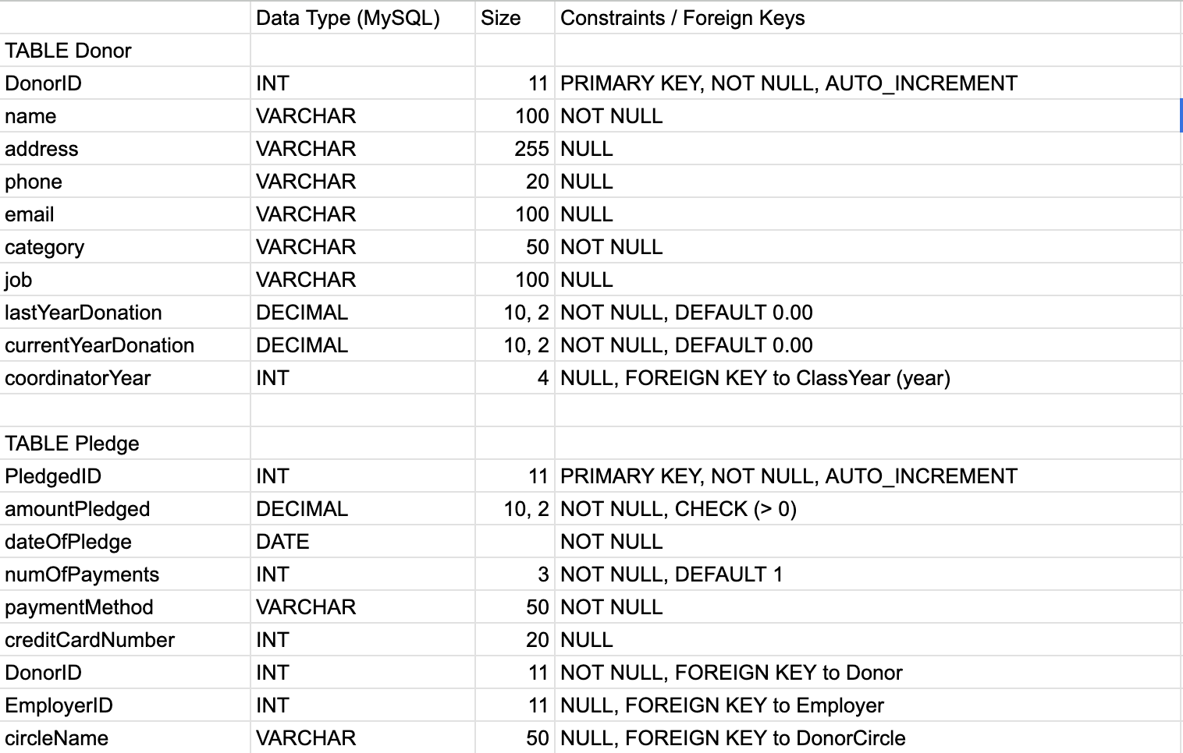
Updated data dictionary

Slide 3
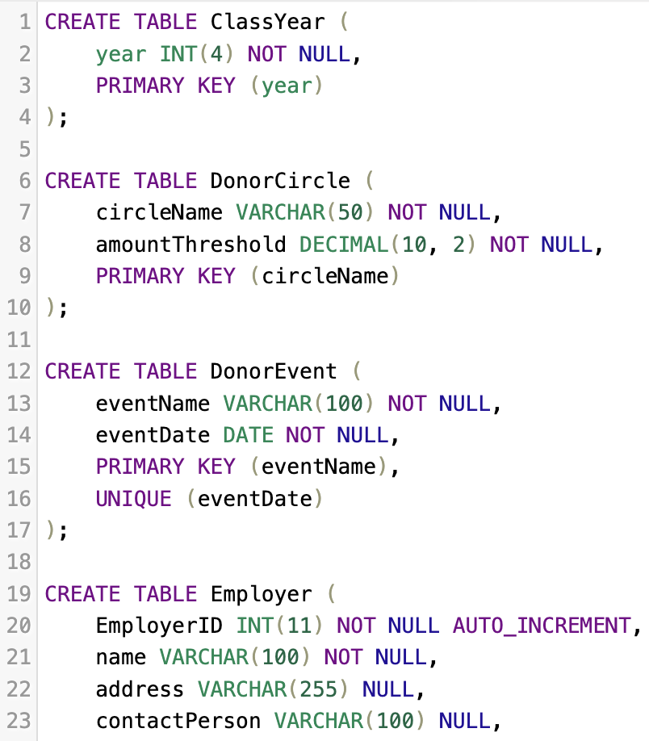
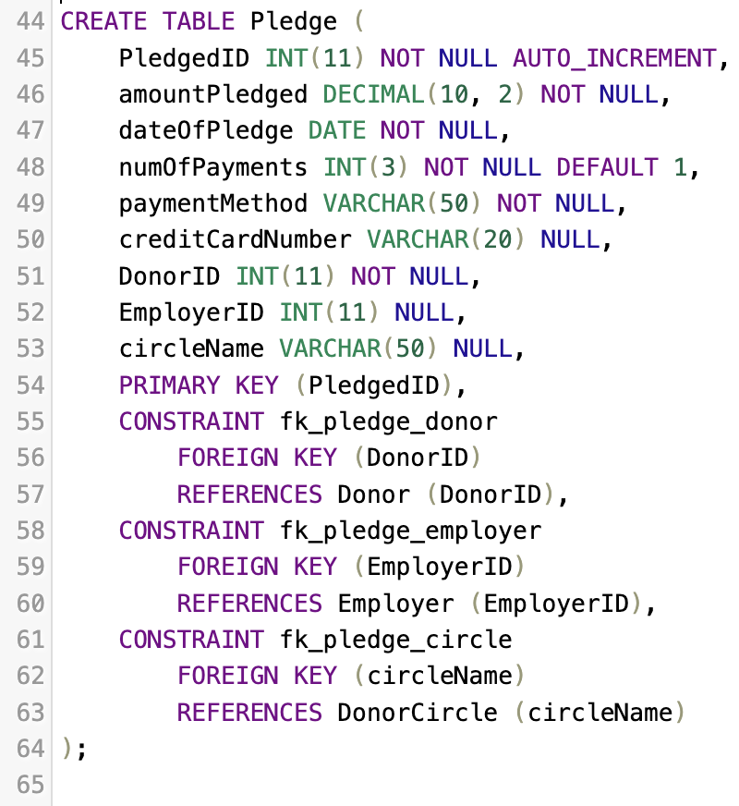
Mysql statements

Slide 4
Inserting records
INSERT INTO ClassYear (year) VALUES (1995);
INSERT INTO ClassYear (year) VALUES (2000);
INSERT INTO ClassYear (year) VALUES (2010);
INSERT INTO ClassYear (year) VALUES (2020);
INSERT INTO ClassYear (year) VALUES (2025);
INSERT INTO DonorCircle (circleName, amountThreshold) VALUES ('Bronze', 100.00);
INSERT INTO DonorCircle (circleName, amountThreshold) VALUES ('Silver', 500.00);
INSERT INTO DonorCircle (circleName, amountThreshold) VALUES ('Gold', 1000.00);
INSERT INTO DonorCircle (circleName, amountThreshold) VALUES ('Platinum', 5000.00);
INSERT INTO DonorCircle (circleName, amountThreshold) VALUES ('Founders', 10000.00);
INSERT INTO DonorEvent (eventName, eventDate) VALUES ('Annual Gala 2024', '2024-11-15');
INSERT INTO DonorEvent (eventName, eventDate) VALUES ('Phonathon Kickoff', '2025-01-20');
INSERT INTO DonorEvent (eventName, eventDate) VALUES ('Spring Mixer', '2025-04-10');
INSERT INTO DonorEvent (eventName, eventDate) VALUES ('Alumni Weekend Lunch', '2025-06-05');
INSERT INTO DonorEvent (eventName, eventDate) VALUES ('Faculty Reception', '2025-09-01');
INSERT INTO Employer (EmployerID, name, address, contactPerson) VALUES (1, 'TechCorp Solutions', '100 Main St', 'Alice Smith');
INSERT INTO Employer (EmployerID, name, address, contactPerson) VALUES (2, 'Global Finance Group', '20 Wall St', 'Bob Johnson');
INSERT INTO Employer (EmployerID, name, address, contactPerson) VALUES (3, 'City Hospital Network', '300 Oak Ave', 'Dr. Carol Lee');
INSERT INTO Employer (EmployerID, name, address, contactPerson) VALUES (4, 'Alpha University', '400 College Dr', 'Dean Davis');
INSERT INTO Employer (EmployerID, name, address, contactPerson) VALUES (5, 'Local Bakery', '50 Market St', 'Eve Adams');

Slide 5
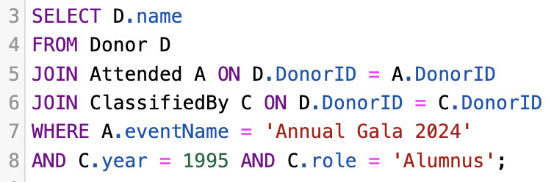

Mysql queries
List the names of all Donors who attended the 'Annual Gala 2024' and also belong to the ClassYear 1995 (as an Alumnus).

Slide 6
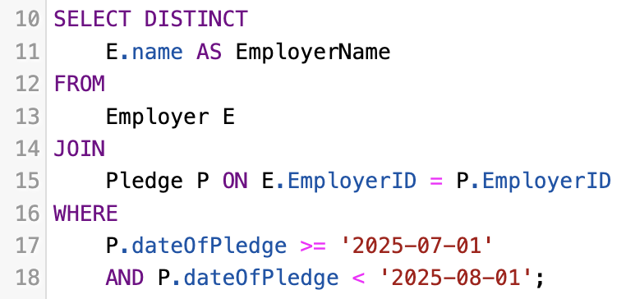

Mysql queries
List the unique names of Employers who had an employee make a pledge in July 2025.

Slide 7
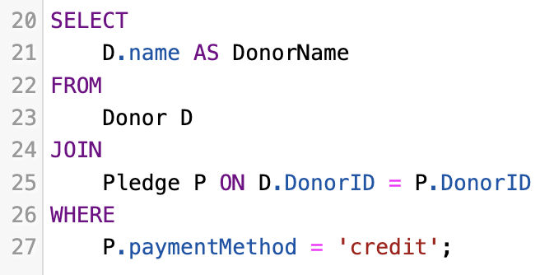
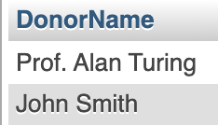
Mysql queries
Find the name of all Donors who made a pledge using 'credit' as the payment method.

Slide 8
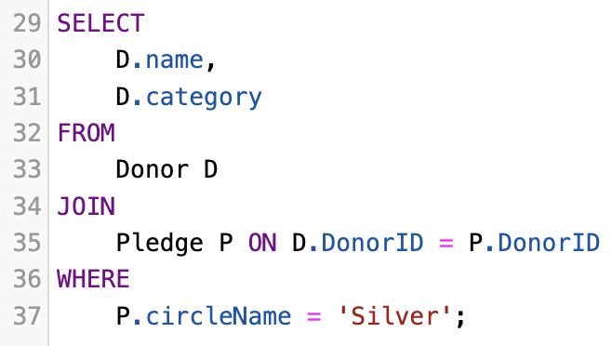

Mysql queries
List the names and categories of all Donors who made a pledge that qualified for the 'Silver' circle.

Slide 9
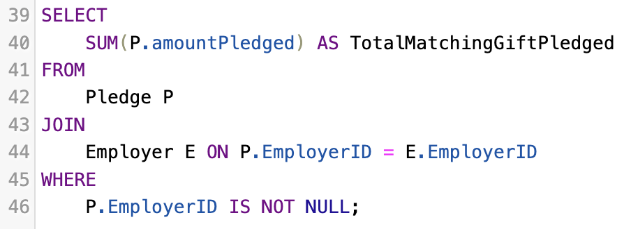

Mysql queries
Calculate the total amount pledged that is eligible for a matching gift (where an EmployerID is present on the pledge).

Slide 10
Thank you!

